Slide 1





Introduction to AI for charities
Courtney Hodge, Program Manager Microsoft
Note: This presentation was enhanced using Copilot, a generative AI tool.
Notes:
Say: Welcome to an Introduction to AI for charities. I am your host [insert name and title]. I’m excited to have you join and learn more about AI and how it can used for your charity.

Slide 2

AGENDA
01
Welcome and introduction
02
What is artificial intelligence
03
Text generators
04
Image generators
05
AI usage policy
06
Wrap-up
Image created with Designer in Copilot
Notes:
Say: Take a moment to review our agenda. We’ll discuss artificial intelligence, text and image generators and talk about the importance of having and following and AI usage policy.

Slide 3


What is artificial intelligence?

Slide 4

What is artificial intelligence?
Artificial intelligence (AI) is the ability of a computer or other machine to perform those activities [or tasks] that are normally thought to require intelligence.
American Heritage Dictionary Entry: artificial intelligence (ahdictionary.com)
Notes:
Say: Let’s begin with a definition. According to the American Heritage Dictionary, artificial intelligence is “the ability of a computer or other machine to perform those activities [or tasks] that are normally thought to require intelligence.”
Do: Advance to the next slide.

Slide 5

AI in the world around us
Speech recognition
Customer service bots
Word prediction
Shopping suggestions
Image analysis
Text analysis
Notes:
Say: AI is everywhere in the world around us. Whether it’s speech recognition to send a voice command to our mobile phone while we’re driving, word prediction to speed up text replies, image analysis to find that perfect household item online, we’re using AI-powered technologies.
Tell a personal story about a recent interaction with AI-powered technology.
I was planning a trip with my parents and my son and I used Copilot to give me a sample itinerary for what we could all do for one of the days we were there.
Do: Advance to the next slide.

Slide 6
A brief history of AI
Artificial Intelligence
1950s
Artificial Intelligence
  the field of computer science that seeks to create intelligent machines that can replicate or exceed human intelligence.
Machine Learning
1959
Machine Learning
  a subset of AI that enables machines to learn from existing data and improve upon that data to make decisions or predictions.
Deep Learning
2017
Deep Learning
  a machine learning technique in which layers of neural networks are used to process data and make decisions.
Generative AI
2021
Generative AI
  create new written, visual, and auditory content when given prompts or existing data.
Notes:
Say: With all this excitement, it might be easy to forget that AI isn’t new. Several momentous milestones in the field have brought us to the inflection point we see today for the transformative potential of AI. Artificial intelligence (AI) has a long and storied history that spans many decades. Some of the earliest work in AI was done in the 1950s and 1960s, when researchers first began to explore the possibility of creating machines that could “think” like humans.
During the 1950s and 1960s, AI research focused primarily on “symbolic” AI, which involved creating symbolic representations of knowledge and using them to solve problems. Researchers in this field developed early versions of what are now known as expert systems, which are computer programs that mimic the decision-making abilities of human experts in a specific domain.
In the 1970s and 1980s, AI research began to shift away from symbolic AI and towards "sub-symbolic” AI, which involves using statistical methods and mathematical models to solve problems. This shift was driven in part by the realization that symbolic AI was too complex and difficult to scale, and in part by the development of new computer hardware that made it possible to process large amounts of data quickly.
In the 1990s and 2000s, AI research continued to evolve, and new subfields began to emerge. One of these was “machine learning,” which focuses on creating algorithms that allow computers to learn from data without being explicitly programmed. Another was “neural networks,” which are mathematical models inspired by the structure and function of the human brain. Recently, generative models like GPT-3 and DALL-E, variational autoencoders, generative adversarial networks, and many more have risen and continue to advance the field of AI.
These models are able to generate new examples that are similar to examples from a given dataset. It is being used in diverse fields such as natural language processing, computer vision, speech recognition, and many more. Overall, AI has come a long way since its inception in the 1950s, and it continues to evolve and improve at a rapid pace today.
Do: Advance to the next slide.

Slide 7



What is generative AI?
Notes:
Say: Generative AI is newer in the education landscape. Generative AI is a subfield of artificial intelligence that focuses on creating systems that can generate new examples, such as images, text, or speech, that are similar to examples from a given dataset. The goal of generative AI is to develop algorithms that can learn the underlying probability distribution of a given dataset and use this knowledge to generate new examples that are similar to the examples in the dataset.
Generative AI models work by using models to extract information from data and use that for learning the probability distribution of data. It can then generate new examples.
Do: Advance to the next slide.

Slide 8

Three Cs of generative AI
Create
Communicate
Code
Notes:
Say: Generative AI is a rapidly growing field within AI, and it has the potential to be used in a wide range of applications, such as computer vision, natural language processing, speech recognition, and many more. It’s easy to remember what generative AI can do by remembering the 3 Cs of generative AI: create, communicate, and code.
Do: Advance to the next slide.

Slide 9
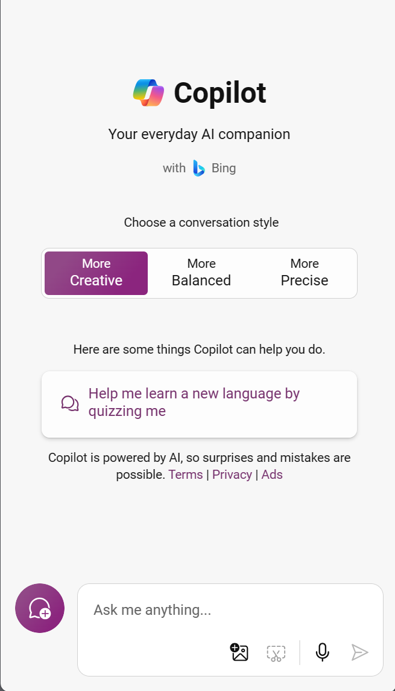
Large language models
Classification
Summarization
Translation
Generation
Dialogue
Notes:
----------------------------------------------------------------------------------------------------------------------------------
Note for instructor preparation: *Reviewing this resource may be helpful in preparing for this part of the training:
https://learn.microsoft.com/en-us/training/modules/explore-azure-openai/5-understand-openai-natural-language
----------------------------------------------------------------------------------------------------------------------------------
Say: Large language model (LLM) AI is a term that refers to AI models that can generate natural language texts from large amounts of data. Large language models use deep neural networks to learn from billions or trillions of words and produce texts on any topic or domain. Large language models also perform various natural language tasks such as:
Classification
Summarization
Translation
Generation
Dialogue
Natural language processing (NLP) enables computers to understand and interpret human language. This type of AI is one of the most common as it is used in chatbots, virtual assistants, and language translation software. The new Bing Chat is an example of an application using a large language model. ChatGPT is also a large language model. Have you heard of either of those models?
Do: Advance to the next slide.

Slide 10





AI at a charity
Program management
Fundraising
Marketing
People development
Administrative tasks
Research best practices, monitor progress and generate reports for their projects
Draft emails and messages to communicate with stakeholders and team members
Find and contact potential donors sponsors and partners
Write proposals grants and thank you letters and track their fundraising goals and outcomes
Create engaging content such as blog posts social media posts newsletters and Flyers
Design and deliver effective training sessions such as webinars workshops and courses
Find relevant sources summarize articles and generate citations
Manage and organize various tasks such as scheduling meetings booking travel ordering supplies and filing documents
Notes:
Charities have many functions, including program management, fundraising, marketing, people development, and administrative tasks. These functions are essential to the success of any nonprofit organization. Program management is responsible for delivering the organization's core mission, while fundraising is responsible for securing the necessary funding to support those programs. Marketing is responsible for promoting the nonprofit's programs and services, while people development is responsible for ensuring that staff and volunteers have the skills and knowledge they need to be effective. Administrative tasks include a wide range of responsibilities, including finance, human resources, and general management.

Slide 11
Microsoft's Responsible AI principles
Fairness
Reliability
& Safety
Privacy
& Security
Inclusiveness
Transparency
Accountability
Notes:
Say: The potential impact of AI in education is worth noting. Charities can evaluate AI-powered tools and help analyze their best fit for their missions and can focus on ensuring AI outputs are fair and inclusive. They can also determine if AI-powered tools are reliable and safe to use in their setting. AI-powered tools should be secure, respect individual privacy, and be understandable. The people developing the AI systems should be accountable for their outputs. These ideas are core to Microsoft’s efforts to govern, enable, and use AI—and charities can use these same principles to critically evaluate AI-powered tools in their classes.
Do: Advance to the next slide.

Slide 12


What prompts are you most interested in creating?
Project management
Fundraising
Marketing
People development
Administrative tasks
Notes:
Say: What prompts are you most interested in creating? Please share in the chat.
Do: Respond to those that are engaging in the chat. Move to the net slide.

Slide 13

Demo: Text generators
Notes:
Demo begins
Say: In this demo let's compose a proposal for a new volunteer program to help with weekly food distribution at our charity's food bank and we want to start a volunteer program to help with food preparation.
Do: Move to next slide

Slide 14
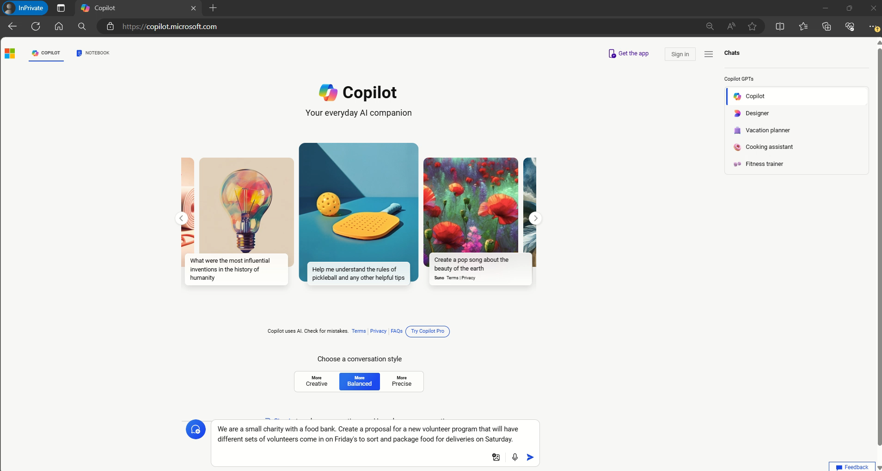
Notes:
Say: The prompt we'll use is: We are a small charity with a food bank. Create a proposal for a new volunteer program that will have different sets of volunteers come in on Fridays to sort and package food for deliveries on Saturday.
Do: Play the video embedded in this slide.
Say: The response from copilot gives an outline of key components of the proposal and program that I can use as starting point for my proposal.
Do: Move to next slide.

Slide 15

Credit for
AI-generated content
Note: This article was created by a person with the assistance of an artificial intelligence (AI).
Notes:
Say: Now, with all of this content creation happening with the support of AI, some people have concerns about how to give credit for that help. At the end of a Microsoft support article about Microsoft Copilot is this statement: Note: This article was created by a person with the assistance of an artificial intelligence (AI).
Do you think this type of statement is important? Why or why not?
Virtual:
Either come off mute or place your answer in the chat.
In person:
Share with someone near you.
Do: Allow wait time for participants to voice or type their opinions.

Slide 16

Accuracy checks
Follow sources
Lateral reading
Iterative prompting
Notes:
Say: Responsible AI is AI that is designed, developed, and deployed with ethical, legal, and societal considerations in mind. This includes considering the potential for unintended consequences, being transparent about how decisions are made, and respecting privacy. Responsible AI also requires building trust and ensuring accountability as well as ensuring that individuals are not discriminated against due to their race, gender, or other protected characteristics.

Slide 17

Image generators
Notes:
Say: Image creators are another tool based on a generative AI model. Image, music, and video generation have been other additions to the world of AI. Generative AI applications use models like DALL-E to generate artistic content from textual prompts. These prompts can be highly imaginative or unusual. Again, the more specifically a prompt is written, the better the result. Prompts might begin with “draw an image” or “create an image.”
Do: Move to the next slide

Slide 18
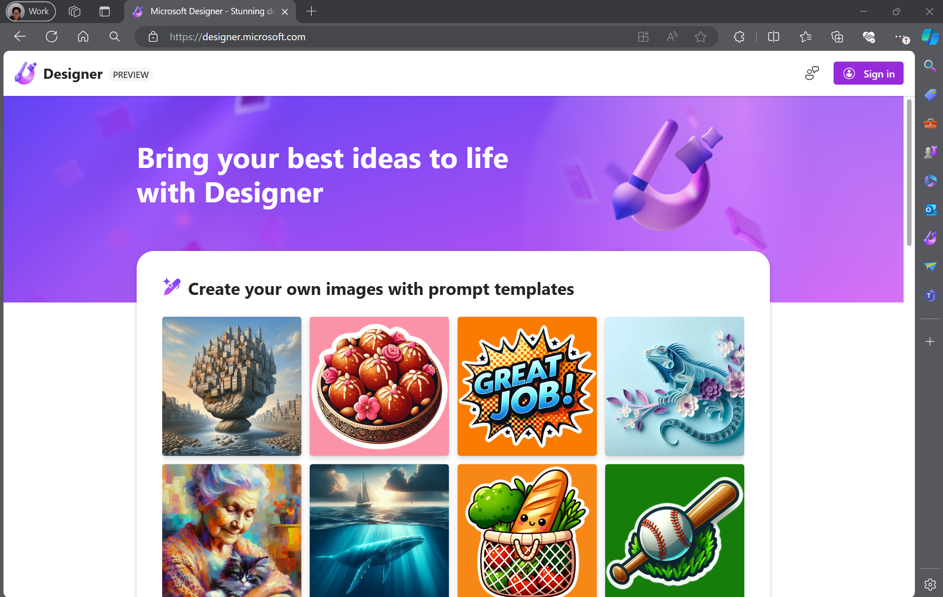
Bing image creator
Notes:
Say: Copilot Designer is an AI-powered tool that generates images from text prompts. Powered by an advanced version of the DALL∙E model from OpenAI, Microsoft Designer creates an image simply by analyzing the words used to describe a picture. It’s a creative copilot! Educators can use this tool to create images for a class newsletter, lesson, or Teams post.
Do: Advance to next slide.

Slide 19
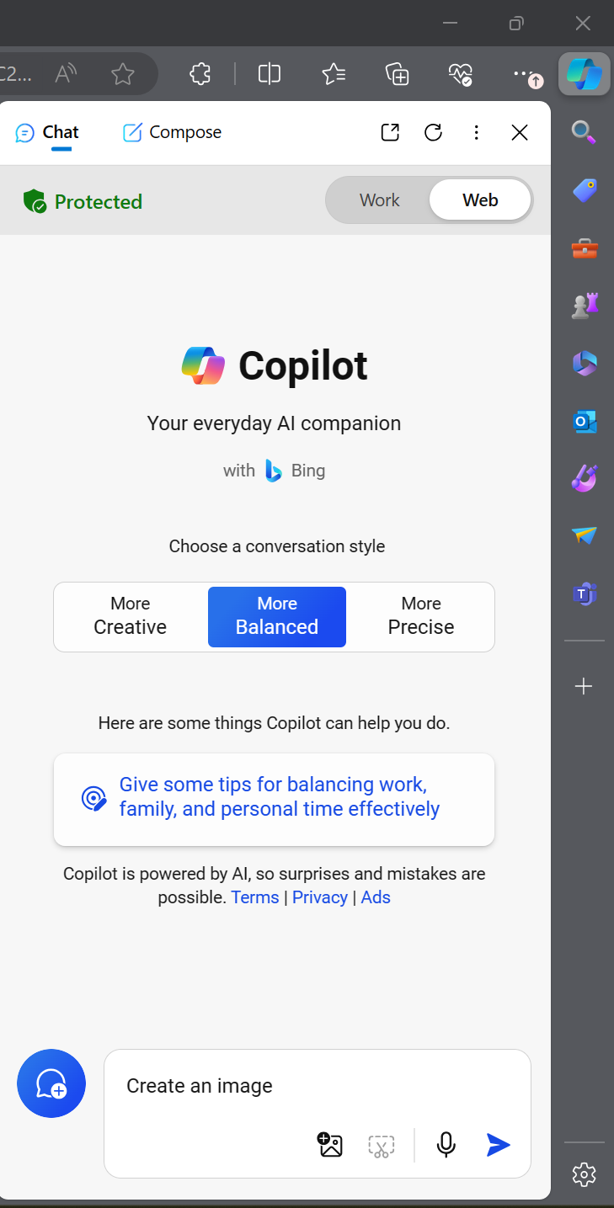
How to access Copilot image generators
copilot.microsoft.com
Start your prompt with “create an image…”
Copilot sidebar in Edge browser
Notes:
Say: Begin generating with Copilot in one of two ways:
Use it directly in Copilot by starting a prompt with the words “create an image…”;
or launch the Copilot sidebar in Edge browser.
You will need to sign in to use image generation
Do: Advance to next slide.

Slide 20

Image generation tip
Use format:
adjective, noun, verb, and style
Example: Green Amazon jungle, glowing at sunset, in a pixel art style
Created by Copilot
Notes:
When creating images in Copilot or Designer, it’s helpful to use a prompt format that includes adjective, noun, verb, and style.
For example, I might write a prompt that requests a green Amazon jungle, glowing at sunset, in a pixel art style.
Take a look at the image AI generated for me with this prompt.
Do: Advance to the next slide.

Slide 21
Demo: Image generators
Notes:
Demo begins
Say: In this demo let’s work to create an image that will go with marketing materials for our new volunteer program for the food bank.
Do: Move to next slide

Slide 22
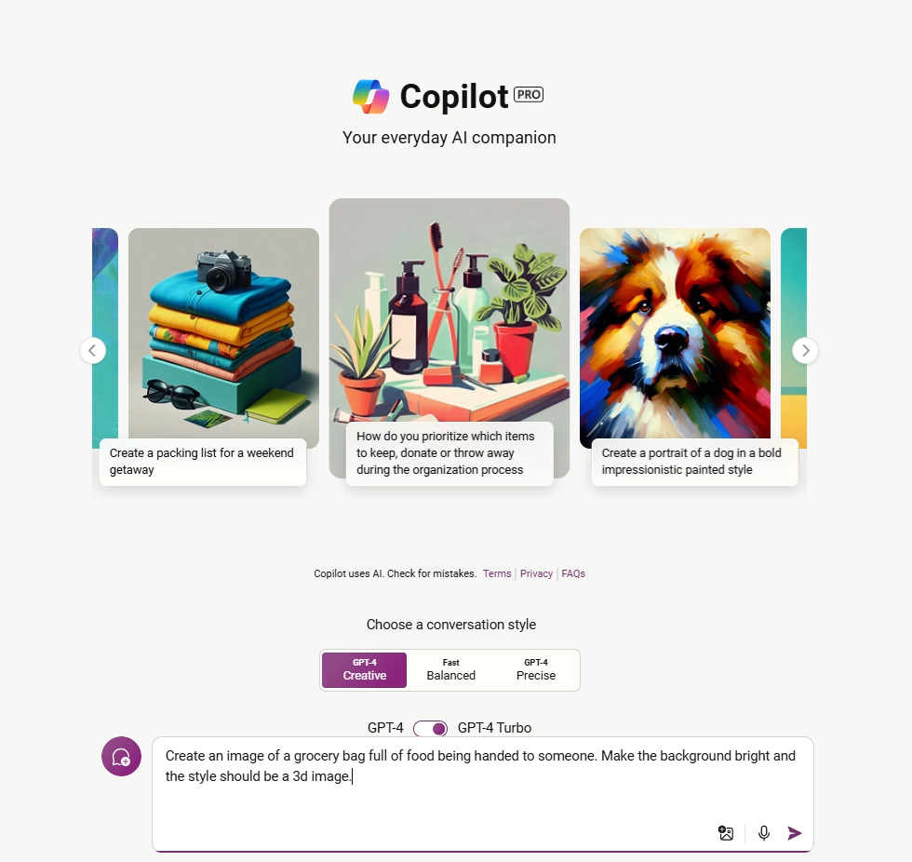
Notes:
Say: The prompt we'll use is: Create an image of a grocery bag full of food being handed to someone. Make the background bright and the style should be a 3d image.
Do: Play the video embedded in this slide. Move to next slide.

Slide 23
Image generator reminders
Generative AI follows patterns but creates unique responses.
Cite your source: Created by Copilot.
Adjust your prompt to adjust the output for your needs.
Notes:
Say: Here are a few reminders as you begin using Copilot to generate imagery. First, AI-generated images will follow a predictive pattern. You might notice they are similar to existing imagery. That is because AI is analyzing existing data—in this case images—and generating new content based on the patterns it recognizes. Second, Copilot Designer gives a source link for the image and a logo in the corner, and you can model digital citizenship for your students by citing Copilot Designer as the source. Finally, prompt engineering is a new skill for many of us. If you don’t get the results you want, change your prompt and try again.
Do: Advance to next slide.

Slide 24

AI usage policy
Content based on AI usage policy guide from TechSoup https://aka.ms/AIUsagePolicyGuideTechSoup
Notes:
Say: Organizations can benefit from having an AI usage policy to provide clarity on the appropriate uses for AI. The content in this section is taken from the AI usage policy guide from TechSoup. This guide is free and you can access it at https://aka.ms/AIUsagePolicyGuideTechSoup
Do: Advance to the next slide

Slide 25





What are the benefits of having an AI usage policy?
Ensure compliance and avoid legal and regulatory issues
Establish trust
Protect sensitive data
Avoid biased or discriminatory output
Encourage a culture of AI awareness
Notes:
Say: Here are some of the benefits of having an AI usage policy. As your organization uses AI you want to make sure it’s done safely and responsibly according to the laws and regulations governing your organization. You want keep in mind security and inclusivity. Let’s go into a few challenges in using AI and how you can face them.
Do: Move to the next slide.

Slide 26
Balancing innovation with risk management
Challenge: Charities must balance AI innovation with risk management, ensuring security, privacy, and fairness while monitoring and mitigating potential threats from generative AI.
Potential solution: Document use cases of tasks that are low-risk and high-risk and those that should be completely avoided so employees are aware of when to use AI. You should also list all the licensed AI tools approved for use.
Notes:
Do: Read the content on the slide and ask for feedback in the chat.

Slide 27

Use AI responsibly and safely
Verify Information: Cross-check AI-generated information with credible sources before using or sharing it.
Data Privacy: Ensure personal data used by AI is handled in compliance with privacy laws and organizational policies.
Continuous Learning: Stay informed about AI developments and ethical considerations.
Notes:
Do: Read the content on the slide and ask for feedback in the chat.

Slide 28

Closing reminders
Check for accuracy
Model digital citizenship
Remember AI usage guidelines
Notes:
Say: When working with AI, keep in mind these important reminders. First, always check your results for accuracy. Second, model digital citizenship by citing how the content was created. And finally, remember and apply any AI usage guidelines for your organization.
Do: Advance to the next slide.

Slide 29

Responsible AI
https://aka.ms/RAI
Notes:
Say: Finally, you can learn more about Microsoft’s approach to responsible AI and commitment to the advancement of AI driven by ethical principles that put people first. Visit aka.ms/RAI to explore responsible AI resource and tools.
You are the change agent who will build a bridge between today and the future for your learners. I’m proud of you for being open to learning more and growing forward with the technology of tomorrow.
Do: Advance to the next slide.

Slide 30
Additional resources

Slide 31





Self-paced AI skills for charities
Intro AI skilling
Micro learning videos
Specialized content:
Program management
Specialized content:
Funding
Build AI skills in the way that works best for you with the AI for nonprofits skills collection.
New AI for nonprofits skills collection on Microsoft Learn
Dive into AI learning
aka.ms/AI-for-nonprofits-collection
Notes:
Say: There is new content on Microsoft Learn geared to nonprofits. There you will find some Introductory content as well as specialized content for program management and funding.
Do: Move to the next slide

Slide 32

Questions

Slide 33

Thanks for joining us today!
Thanks for joining us today!
© Copyright Microsoft Corporation. All rights reserved.
Notes:
Say: Thank you for your time and attention today. You have been wonderful, and I have loved learning from you. If you have any questions or final thoughts, please feel free to share them in the chat window or unmute yourself and share.
Do: Close the presentation. If recording, make sure you tell participants how they can access the recording of the session.

