Slide 1





Prompt engineering for charities
Courtney Hodge, Program Manager Microsoft
Note: This presentation was enhanced using Copilot, a generative AI tool.
Notes:
Say: Thank you for joining today's session on prompt engineering for charities I'll be your host Courtney Hodge program manager at Microsoft
Do: Move to the next slide

Slide 2

AGENDA
01
Welcome and introduction
02
Copilot overview
03
Prompt writing
04
Scenarios
05
Resources
06
Questions and wrap-up
Image created with Designer in Copilot
Notes:
Take a moment to review the agenda for today. First we'll go through an overview of copilot, then talk about prompt writing, I’ll then introduce some scenarios that might be familiar at charities, followed by sharing some resources and finally we'll closeout with questions.

Slide 3



Copilot overview
Notes:
Let's start with an overview of copilot

Slide 4

Features
 | Copilot | Copilot PRO with Commercial Data Protection
GPT Large Language Model | ✓ | ✓
AI-Powered Web Search | ✓ | ✓
Image generation | ✓ | ✓
Commercial Data Protection |  | ✓
Notes:
Let's talk about the different features of copilot depending on the type of Copilot you're using. If you visit copilot.microsoft.com and sign in, you will either access the free version of copilot or Copilot Pro with Commercial Data Protection. These two versions of copilot are similar in the way that they are built on the GPT large language model, both have AI powered search and image generation however only Copilot Pro with Commercial Data Protection has commercial data protection.

Slide 5
Data protection
To help business and educational organisations protect corporate data, Copilot adds commercial data protection when eligible users sign in with their work or school
accounts.
Commercial data protection means user and organisational data are protected, prompts and responses are not saved, Microsoft has no eyes-on access, and chat data isn't used to train the underlying large language models.
Notes:
In order to help business and educational organisations protect their data copilot adds commercial data protection to eligible users when they sign into their work or school accounts. This level of protection ensures that your organisational data is protected, your prompts and responses are not saved, Microsoft has no eyes-on access and chat data isn't used to train the underlying large language models.

Slide 6
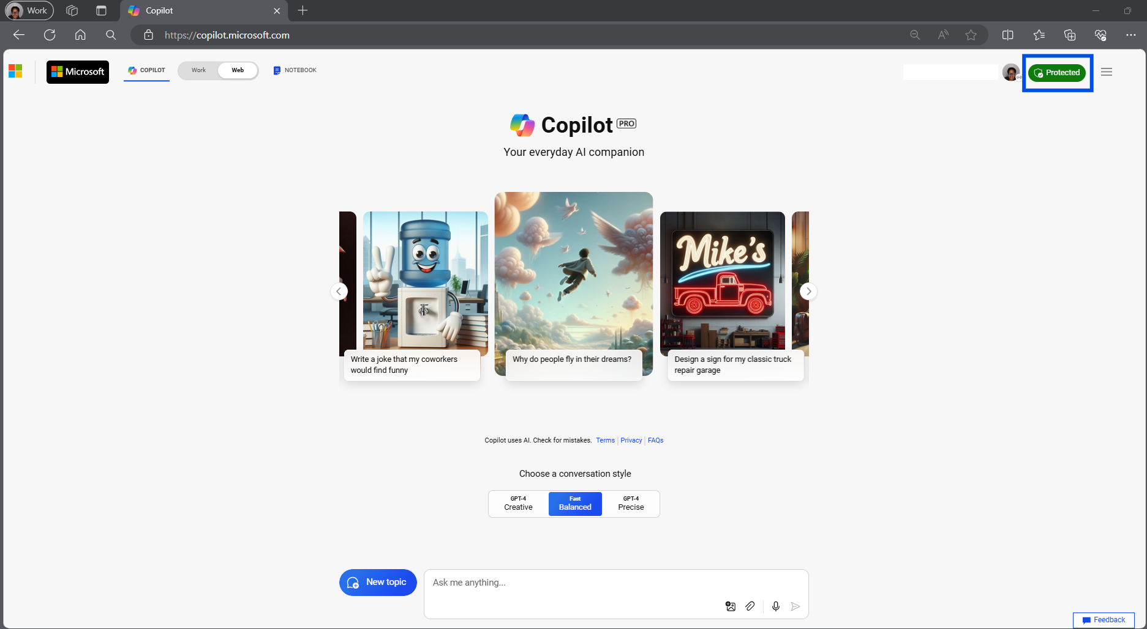
Copilot landing page
Notes:
When you sign in at copilot.microsoft.com and see a protected icon it means you have Copilot Pro with commercial data protection if you don't see protected when you sign in at copilot.microsoft.com be mindful of the type of data you put in the chat and you'll want to avoid entering highly confidential or sensitive information in the chat.

Slide 7
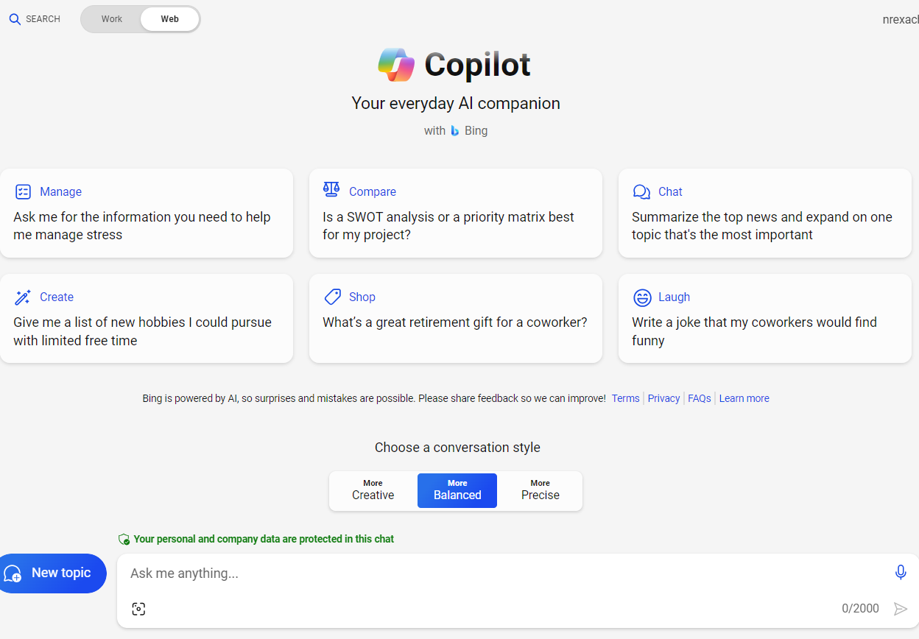



Meet Copilot
More Creative: This style delivers reasonable responses with a creative touch. This style allows the AI more creative leeway in how it formulates answers to your queries.
More Balanced: This is the default conversational mode, and it tries to strike a balance between accuracy and creativity during your conversations.
More Precise: In this mode, responses are more likely to
be factual, concise and accurate. The chatbot places more focus on relevancy when formulating results.
Notes:
There are three different conversation styles in Copilot. Creative gives responses that have the most creative touch and allows the AI to have more leeway in how it formulates answers to your questions. Precise will lead you to more factual and concise responses and the balanced approach strives to strike a balance between creative and precise.

Slide 8





Workday efficiencies
Summarise a
long PDF
Draft emails and social content
Generate
images
Learn new skills
Get answers for specific and complex questions
Turn a 20-page, jargon-filled PDF into 5 bullets using Copilot in the Edge sidebar
Use Copilot as your professional writer on call to draft emails, captions,
and more
Leave behind stock images and text-only reports in favor of custom-generated images for emails, on social, and more
Ask questions tailored to your needs and interests to get consolidated key points from the internet for you
Elegantly handle questions that require multiple data points
or a degree of analysis
Notes:
There are several ways that using copilot can add efficiencies to your work day. You can summarise a long PDF, draft emails and social content, generate images, learn new skills or get answers for specific and complex questions.

Slide 9

What do you want to try with Copilot first?
summarise document
Compose email
Compose social media post
Generate images
Learn new skills
Get answers for specific and complex questions
Notes:
What do you want to try with copilot first? Share your answers in the chat.

Slide 10


Types of prompts
Notes:
Let's talk about different types of prompts.

Slide 11


Different prompts, different results
Zero-shot prompts: Asks a single question, AI answers
One-shot prompts: Add one example with the prompt
Few-shot prompts: Include multiple examples with the prompt
Get-in-character prompts: Ask the AI to assume a certain role or perspective while generating a response
Chain-of-thought or changing prompts: Uses a series of questions that prompt the AI to reason out the answer
https://aka.ms/TechSoup
Notes:
There are several different types of prompts and depending on what prompts you choose you can get different results. Let's go over a few. Zero shot, one shot and few shot prompts involve asking the AI a question but in a one shot and a few shot prompt you also give the AI examples of your what type of responses you are looking for. Get in character prompts ask the AI to assume a certain role or perspective when it's generating a response and chain of thought or changing prompts use a series of questions that prompt the AI to reason out the answers.

Slide 12


Prompting best practices
Notes:
Now that you know the different types of prompts let's talk about prompting best practices.

Slide 13

Prompt ingredients
Include the right prompt ingredients
To get the best response, it’s important to focus on some of the key elements below when phrasing your Copilot prompts.
Goal: What response do you want
from Copilot?
Context: Why do you need it and who is involved?
Generate a short 3-5 article reading list to inform me on nonprofit initiatives in the UK. Focus on journals and blogs. Please summarise each article.
Expectations: How should Copilot respond to best meet your expectations?
Source: Which information sources or samples should Copilot use?
Notes:
You can always just simply ask the AI a question and get a response. But if you're not getting the results that you need you may want to think about the prompt ingredients. The four prompt ingredients are
Goal: what response do you want from copilot
Context: why do you need it and who is involved
Expectations: how should Copilot respond to best meet your expectations and
Source: which information sources or samples should Copilot use.
In this example my goal is to generate a short three to five article reading list, my context is I need it to inform me on nonprofit initiatives in the UK. For my source I asked Copilot to focus on journals and blogs and for my expectations I'm asking copilot to please summarise each article.

Slide 14





Functions at a charity
Program management
Funding
Marketing
People development
Administrative tasks
Research best practices, monitor progress and generate reports for their projects
Draft emails and messages to communicate with stakeholders and team members
Find and contact potential donors sponsors and partners
Write proposals grants and thank you letters and track their fundraising goals and outcomes
Create engaging content such as blog posts social media posts newsletters and Flyers
Design and deliver effective training sessions such as webinars workshops and courses
Find relevant sources summarise articles and generate citations
Manage and organize various tasks such as scheduling meetings booking travel ordering supplies and filing documents
Notes:
Nonprofits have many functions, including program management, fundraising, marketing, people development, and administrative tasks. These functions are essential to the success of any nonprofit organisation. Program management is responsible for delivering the organisation's core mission, while fundraising is responsible for securing the necessary funding to support those programs. Marketing is responsible for promoting the nonprofit's programs and services, while people development is responsible for ensuring that staff and volunteers have the skills and knowledge they need to be effective. Administrative tasks include a wide range of responsibilities, including finance, human resources, and general management.

Slide 15

Demo: Program management

Slide 16

Program management scenario 1
Scenario: A charity is launching a new community health initiative and needs to establish a program management framework to oversee the project’s execution, from planning to evaluation.
Prompt: Develop a comprehensive program management plan that outlines objectives, timelines, resource allocation, monitoring mechanisms, and impact assessment methods for a new community health initiative for a charity.
Notes:
Read the sample scenario and example prompt.

Slide 17
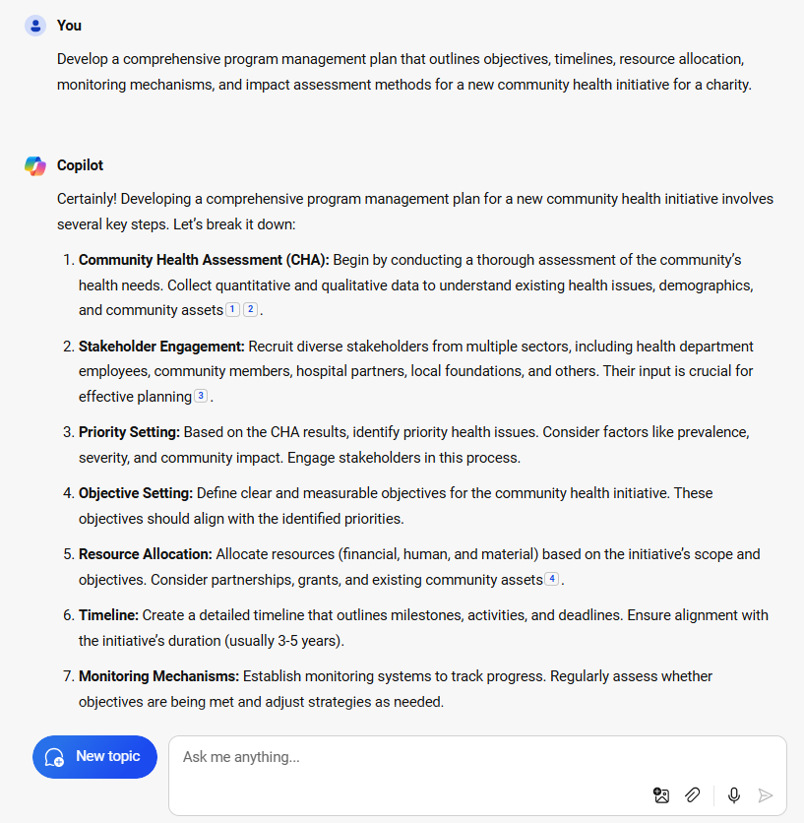
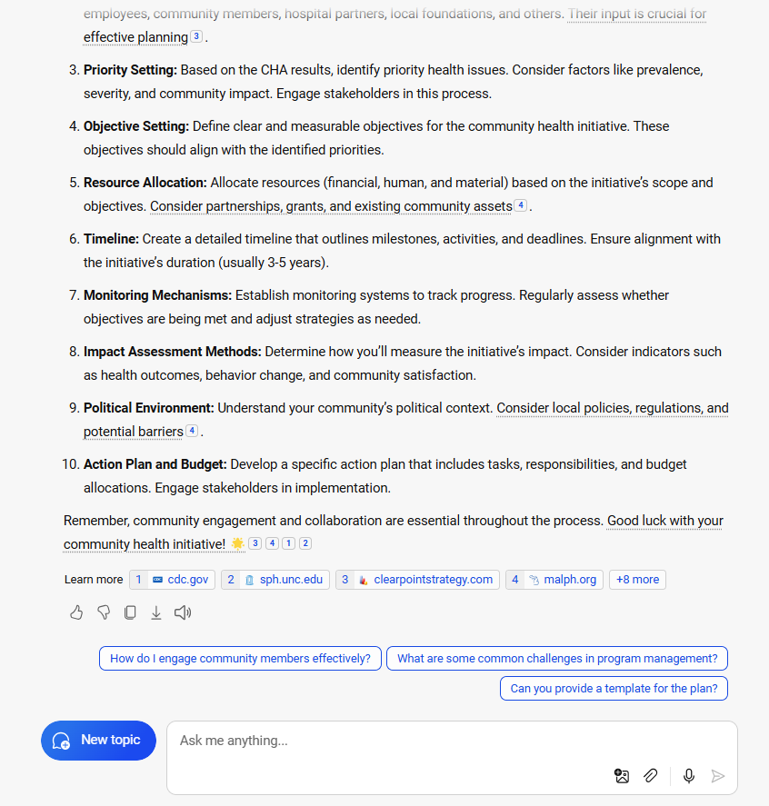
Sample from copilot
Notes:
As you can see copilot identified several steps for developing a program management plan including stakeholder engagement objective setting timeline resource allocation and monitoring mechanisms.

Slide 18
Program management scenario 2
Scenario: A charity focused on youth development is experiencing rapid growth and requires a scalable program management system to handle multiple projects simultaneously without compromising quality.
Prompt: Propose a scalable program management system that includes tools for project tracking, stakeholder communication, and quality assurance to support the organisation’s expanding portfolio of youth programs.
Notes:
Read the sample scenario and example prompt.

Slide 19
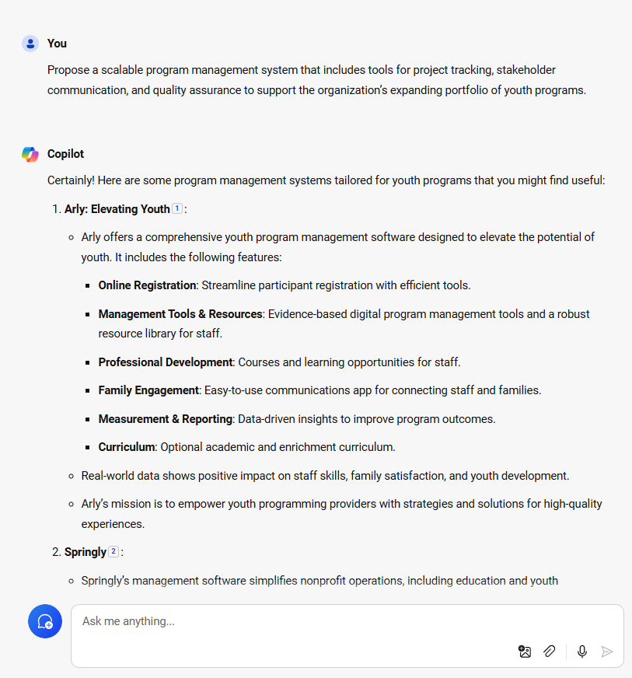
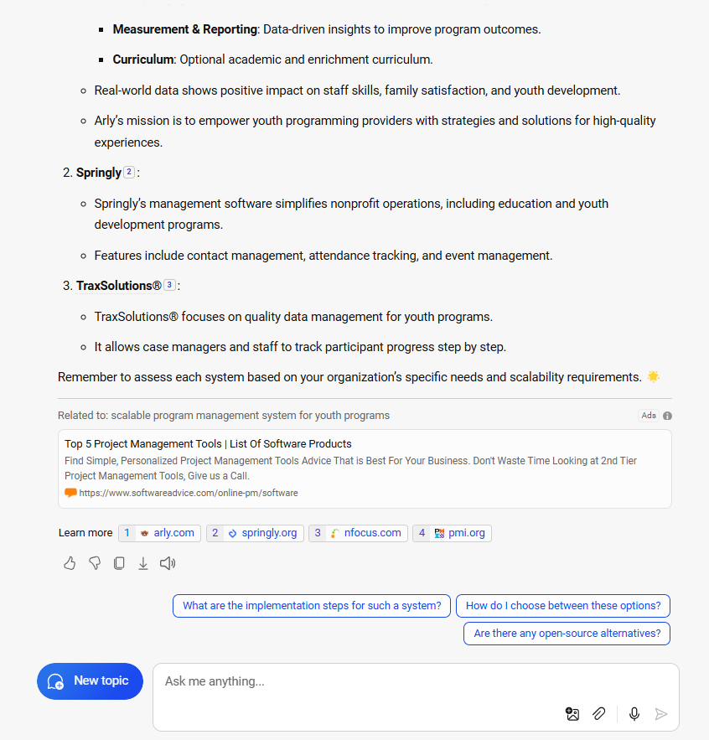
Sample from copilot: program management 2
Notes:
Here copilot has identified program management systems that might work to support our organizations expanding portfolio of youth programs.

Slide 20
Program management scenario 3
Your Scenario: Think of a scenario that is relevant to your organisation and role.
Your Prompt: Write one sample prompt that you could use for program management based on your scenario.
Notes:
Now you try. think of a scenario that is relevant to your organisation and role and write 1 sample prompt that you could use for program management based on your scenario. Share your responses in the chat.

Slide 21
Demo: Marketing

Slide 22
Marketing
Scenario 1
Scenario: Our org wants to send emails to first-time donors that supported our fundraising campaign.
Prompt: Write a donor-centric thank-you email to first-time donors for contributing to our fundraising campaign in May 2024. Include the following details: the donation will help create a new shelter for animals, which will help Pets4All treat more than 200 rescues in the county. Keep the tone grateful and make sure it doesn't exceed 100 words.
Notes:
Read the sample scenario and example prompt.

Slide 23
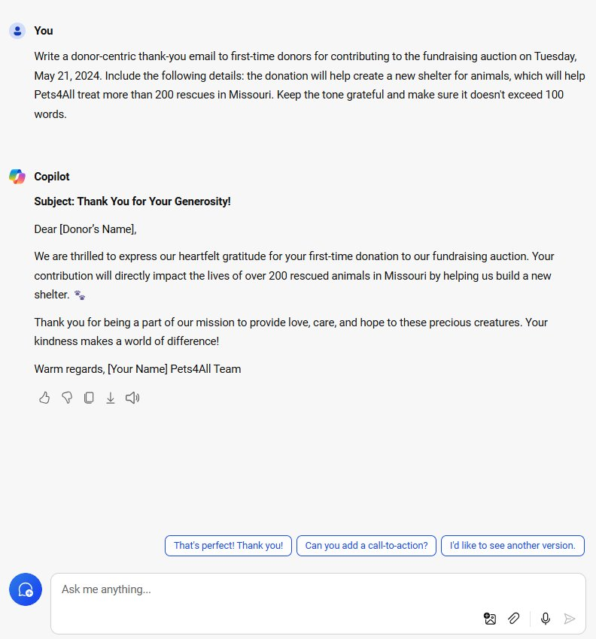
Sample copilot response 4
Notes:
Copilot was able to create a short and simple donor thank you e-mail.

Slide 24
Marketing
Scenario 2
Scenario: Our org wants to share information about our summer volunteering initiative. We want to advertise on X, LinkedIn and Facebook.
Prompt: Our organisation is running a summer volunteer initiative for career coaching for career switchers. Can you create social media postings for X, LinkedIn and Facebook?
Notes:
Read the sample scenario and example prompt.

Slide 25
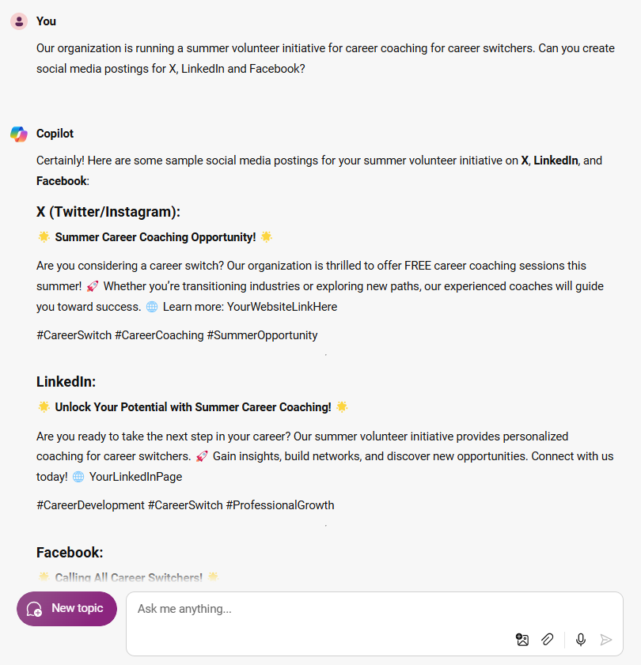
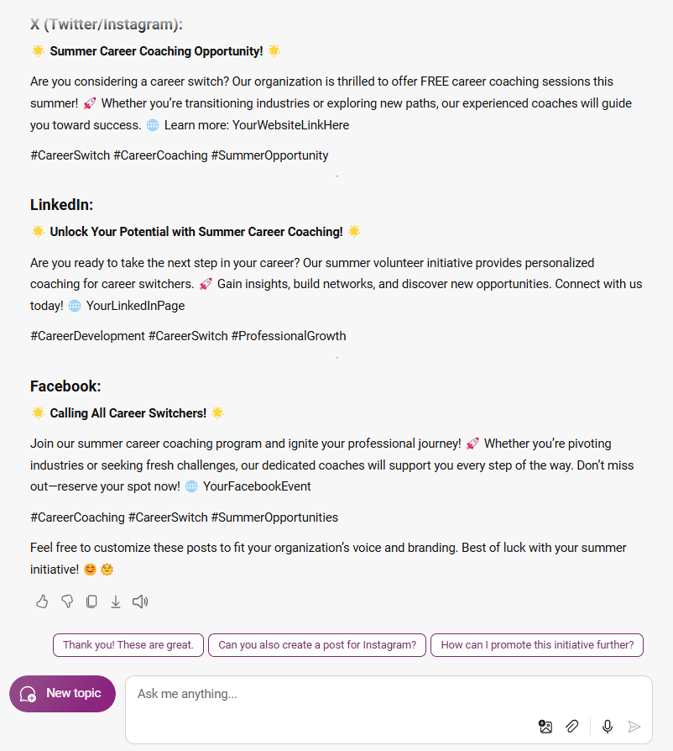
Sample copilot response 5
Notes:
Here we see copilot has responded to our prompt by giving us examples social media postings for each of the social media sites that we mentioned.

Slide 26
Marketing
Scenario 3
Your Scenario: Think of a scenario that is relevant to your organisation and role.
Your Prompt: Write one sample prompt that you could use for marketing based on your scenario.
Notes:
Now you try. think of a scenario that is relevant to your organisation and role and write 1 sample prompt that you could use for marketing based on your scenario. Share your responses in the chat.

Slide 27
Demo: Funding

Slide 28
Funding scenario 1
Scenario: Our charity organisation is focused on hunger relief and is planning to participate in Giving Tuesday for the first time. We are curious about what other campaigns have gone well.
Prompt: Name some popular Giving Tuesday campaign Ideas for food banks in the UK in 2023.
Notes:
Read the sample scenario and example prompt.

Slide 29
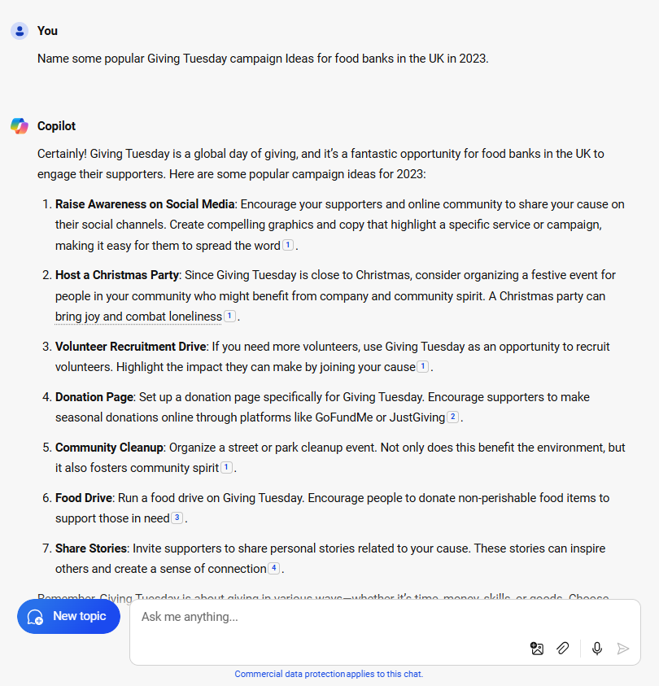
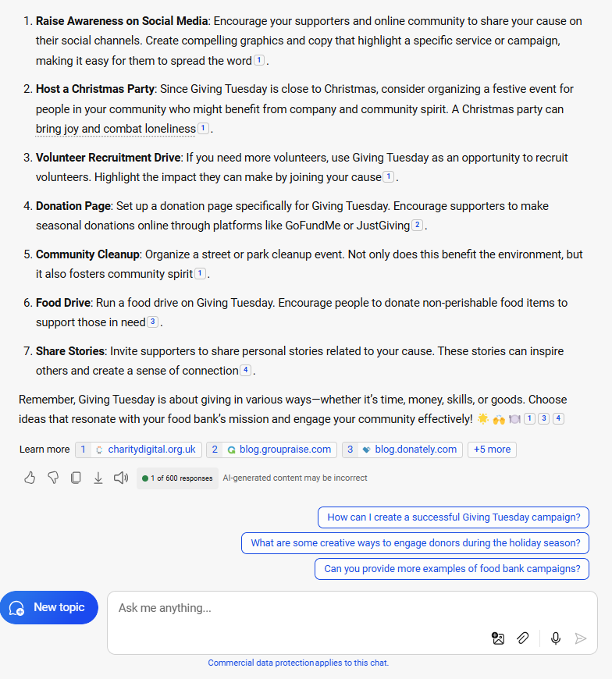
Sample copilot response 1
Notes:
Copilot was able to give us several ideas for a giving Tuesday campaign.

Slide 30
Funding scenario 2
Your Scenario: We are the digital innovation team at a small child rights organisation, uniting to craft digital strategies that will captivate and inspire a new generation of donors.
Prompt: Provide five ideas for a digital fundraising strategy for a small organisation that works for child rights, to help us bring in new donors.
Notes:
Read the sample scenario and example prompt.

Slide 31
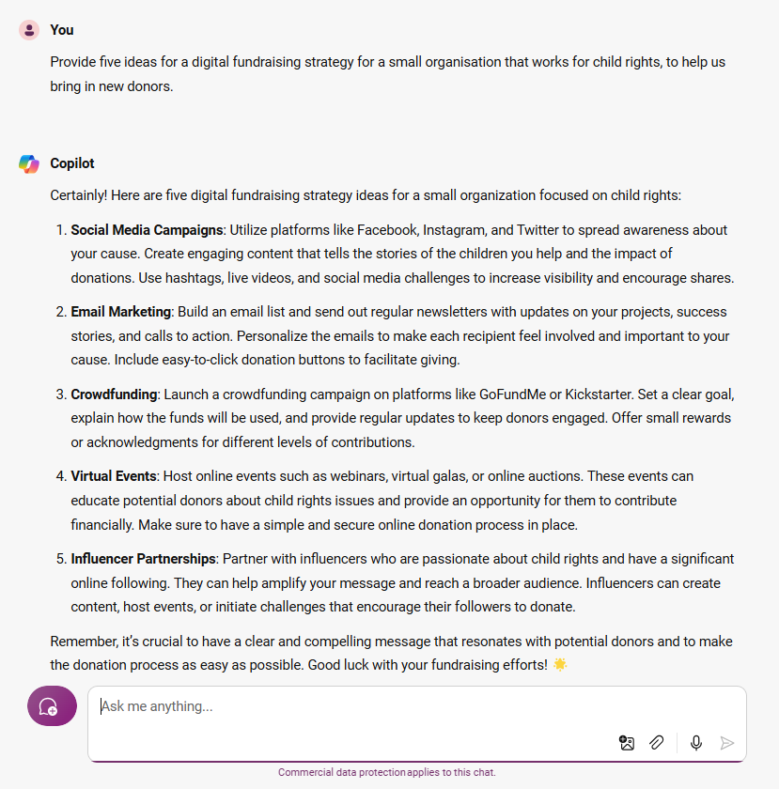
Sample copilot response 3
Notes:
Copilot was able to give us five ideas for digital fundraising strategies including social media campaigns crowdfunding and influencer partnerships.

Slide 32
Funding scenario 3
Your Scenario: Think of a scenario that is relevant to your organisation and role.
Your Prompt: Write one sample prompt that you could use for funding based on your scenario.
Notes:
Now you try. think of a scenario that is relevant to your organisation and role and write 1 sample prompt that you could use for funding based on your scenario. Share your responses in the chat.

Slide 33
Demo: People development

Slide 34
People development scenario 1
Scenario: A charity dedicated to disaster relief is seeking to enhance its volunteer training program to include up-to-date emergency response techniques and technology use in the field.
Prompt: Create a dynamic training curriculum for volunteers that incorporates the latest in emergency response protocols and technology, ensuring they are prepared for effective disaster relief efforts.
Notes:
Read the sample scenario and example prompt.

Slide 35
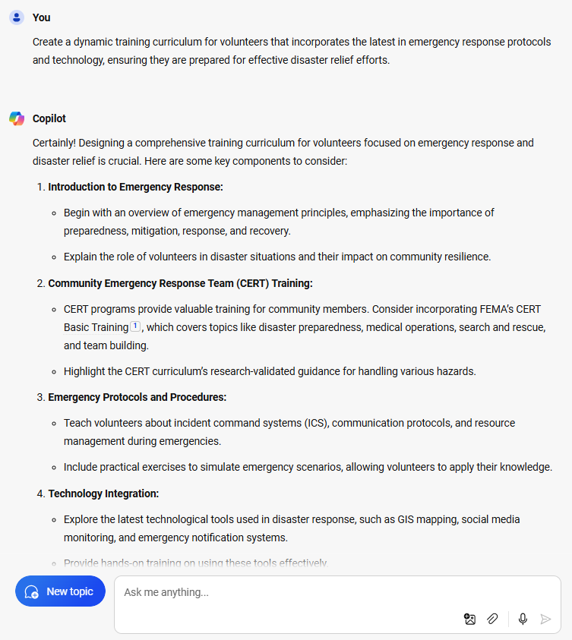
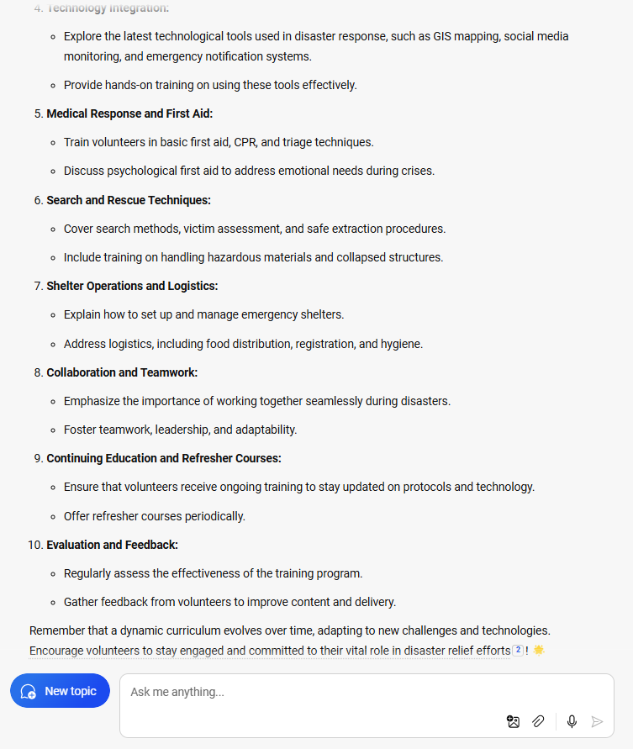
Sample from copilot: People development 1
Notes:
Here copilot has outlined several components of a training curriculum for volunteers.

Slide 36
People development scenario 2
Scenario: An animal welfare charity wants to provide specialized training for its staff on new regulations and best practices in animal care and rescue operations.
Prompt: Design a specialized training workshop for staff that covers recent changes in animal welfare legislation and introduces best practices for care and rescue operations, including hands-on sessions.
Notes:
Read the sample scenario and example prompt.

Slide 37
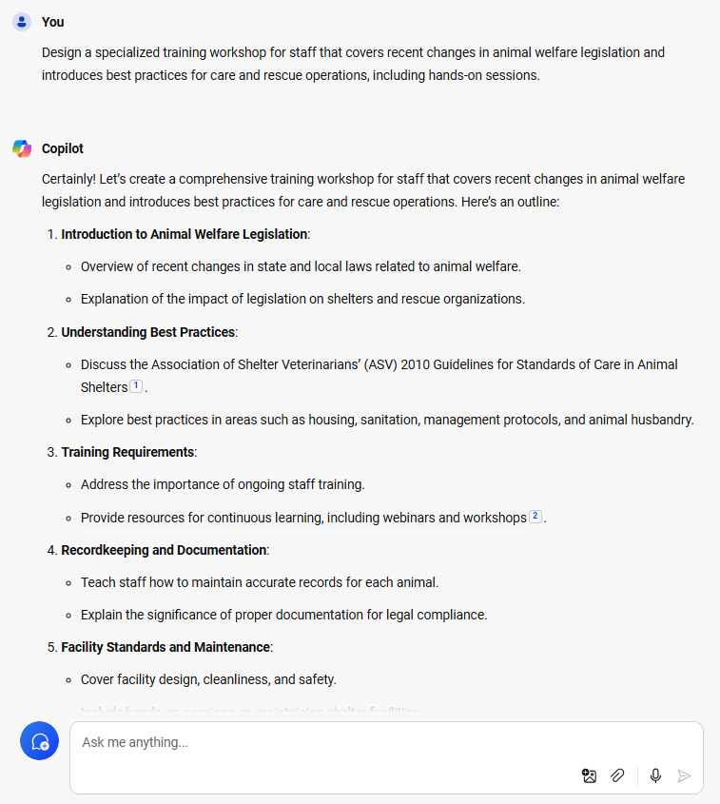
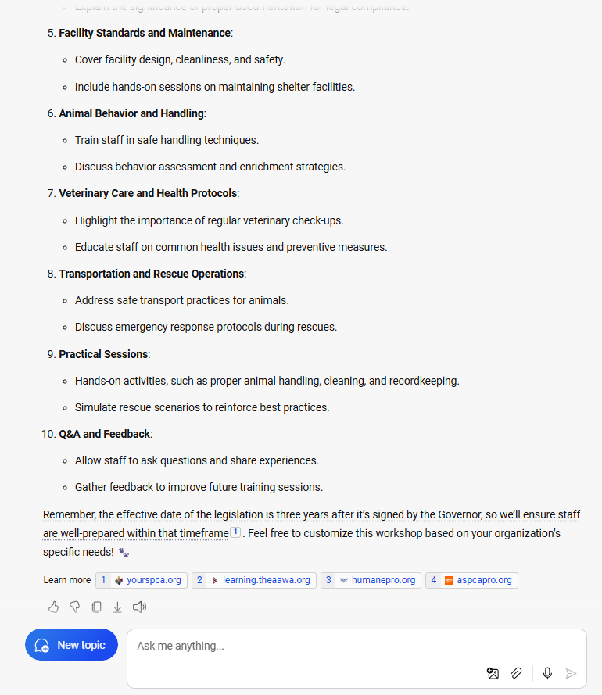
Sample from copilot: People development 2
Notes:
Copilot has outlined components of a training workshop for our staff that begins with introduction to animal welfare legislation, goes through record keeping and documentation, includes a practical session, and closes with Q&A and feedback.

Slide 38
People development scenario 3
Your Scenario: Think of a scenario that is relevant to your organisation and role.
Your Prompt: Write one sample prompt that you could use for people development based on your scenario.
Notes:
Now you try. think of a scenario that is relevant to your organisation and role and write 1 sample prompt that you could use for people developpment based on your scenario. Share your responses in the chat.

Slide 39
Demo: Administrative tasks

Slide 40
Administrative tasks scenario 1
Scenario: Our charity is planning a large fundraising event and needs to manage a multitude of tasks such as coordinating with vendors, tracking RSVPs, and handling logistics.
Prompt: Create a comprehensive checklist and timeline for an upcoming fundraising event that includes vendor coordination, guest management, and logistical arrangements. Ensure there is a clear communication plan for team members and volunteers involved in the event.
Notes:
Read the sample scenario and example prompt.

Slide 41
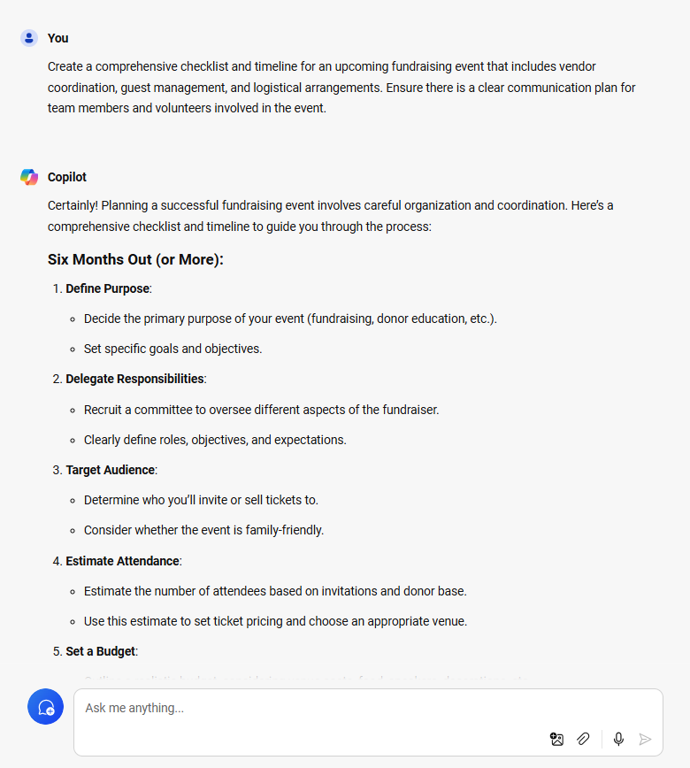
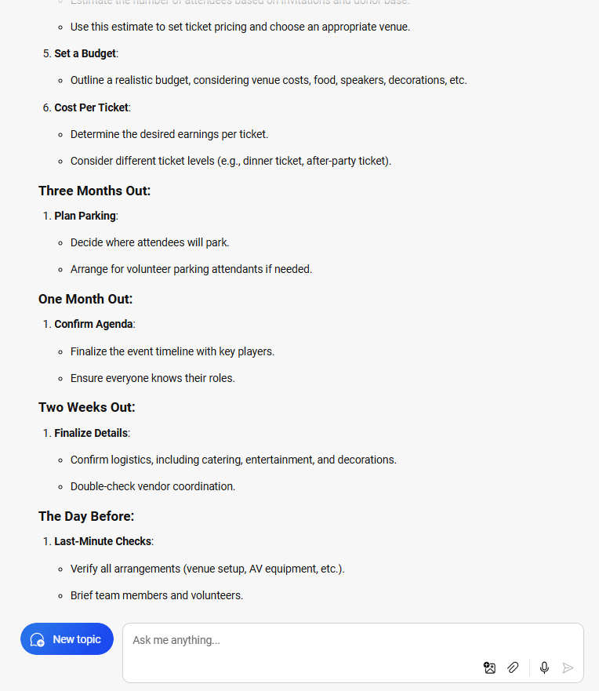
Sample from copilot: Administrative tasks 1
Notes:
Say: Copilot was able to give us a work back schedule starting with six months out going to the day before...
Do: move to next slide

Slide 42
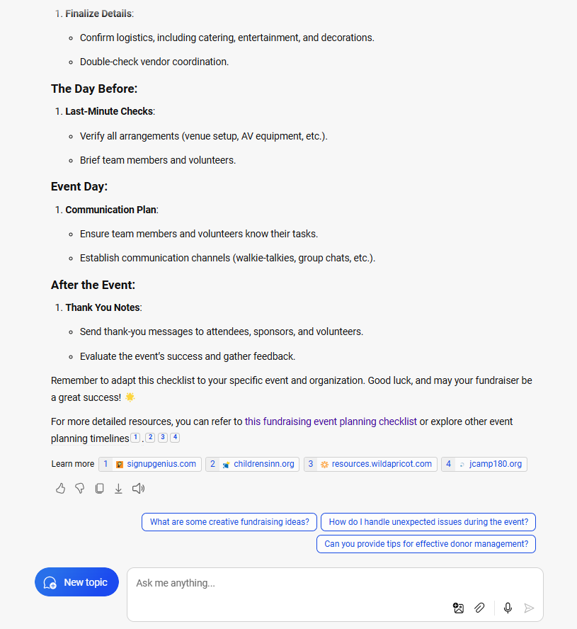
Sample from copilot: Administrative tasks 1 part 2
Notes:
and finally ending with the event day and even extending to some after the event tasks.

Slide 43
Administrative tasks scenario 2
Scenario: Our charity receives a high volume of inquiries from potential donors, volunteers, and beneficiaries. There is a need for an efficient system to categorize and respond to these inquiries promptly.
Prompt: Develop a system for managing incoming inquiries that categorizes each message by its nature (donation, volunteer, assistance request) and urgency. Outline a protocol for responding to each category, including templates for common responses and a triage system for prioritizing messages.
Notes:
Read the sample scenario and example prompt.

Slide 44
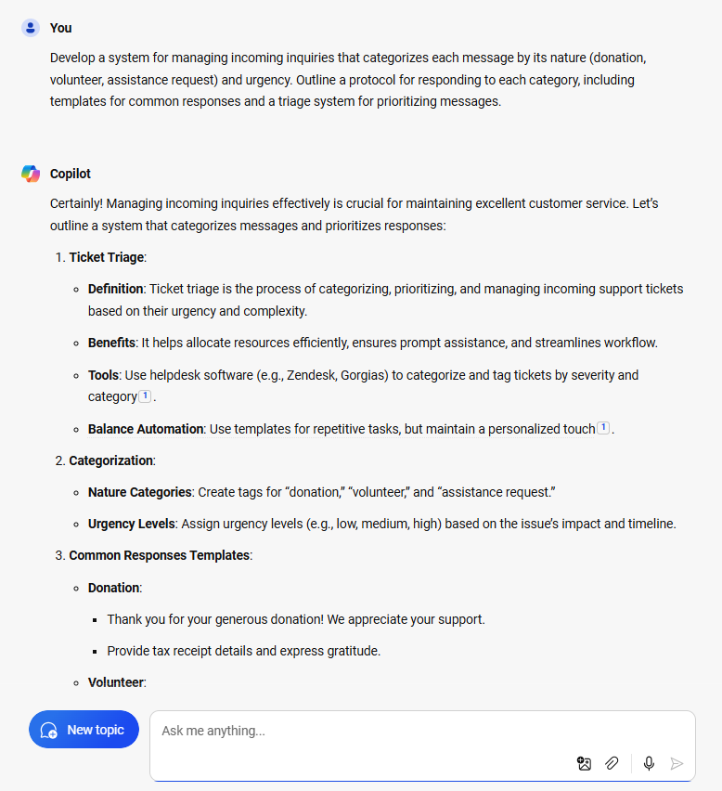
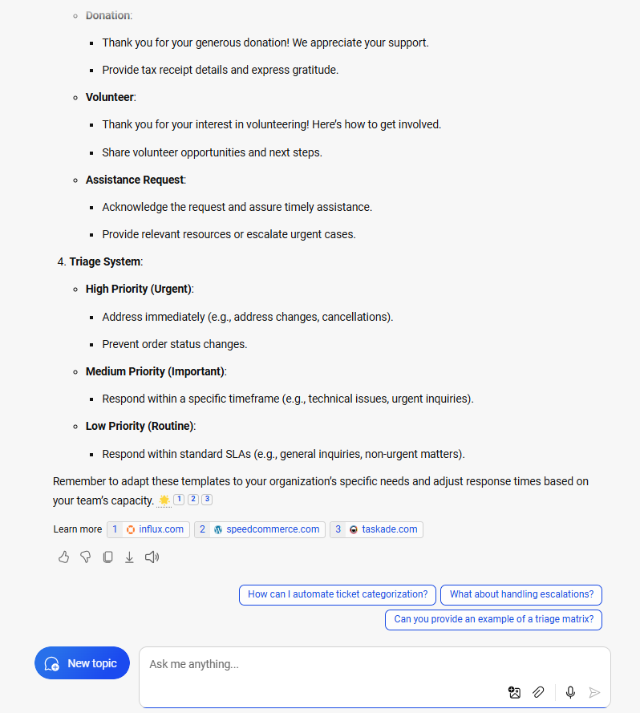
Sample from copilot: Aministrative taks 2
Notes:
Here copilot has developed a sample system for managing incoming questions beginning with ticket triage going through categorization and common response templates.

Slide 45
Administrative tasks scenario 3
Your Scenario: Think of a scenario that is relevant to your organisation and role.
Your Prompt: Write one sample prompt that you could use for administrative tasks based on your scenario.
Notes:
Now you try. think of a scenario that is relevant to your organisation and role and write 1 sample prompt that you could use for administrative tasks based on your scenario. Share your responses in the chat.

Slide 46


Connect. Learn. Innovate.
Together.
Keep the conversation going!
Join the Nonprofit Community
aka.ms/nonprofitcommunity
Notes:
If you'd like to connect with other nonprofits and charities, join the nonprofit community at aka.ms/nonprofitcommunity. This community is an opportunity for you to connect with and chat with other charities and nonprofits while also connecting you to Microsoft events and support for Microsoft technologies.

Slide 47





Self-paced AI skills for charities
Intro AI skilling
Micro learning videos
Specialized content:
Program management
Specialized content:
Funding
Build AI skills in the way that works best for you with the AI for nonprofits skills collection.
New AI for nonprofits skills collection on Microsoft Learn
Dive into AI learning
aka.ms/AI-for-nonprofits-collection
Notes:
Say: There is new content on Microsoft Learn geared to nonprofits. There you will find some Introductory content as well as specialized content for program management and funding.
Do: Move to the next slide

Slide 48

Questions

Slide 49

Thank you!
Thank you!

